Slide 1
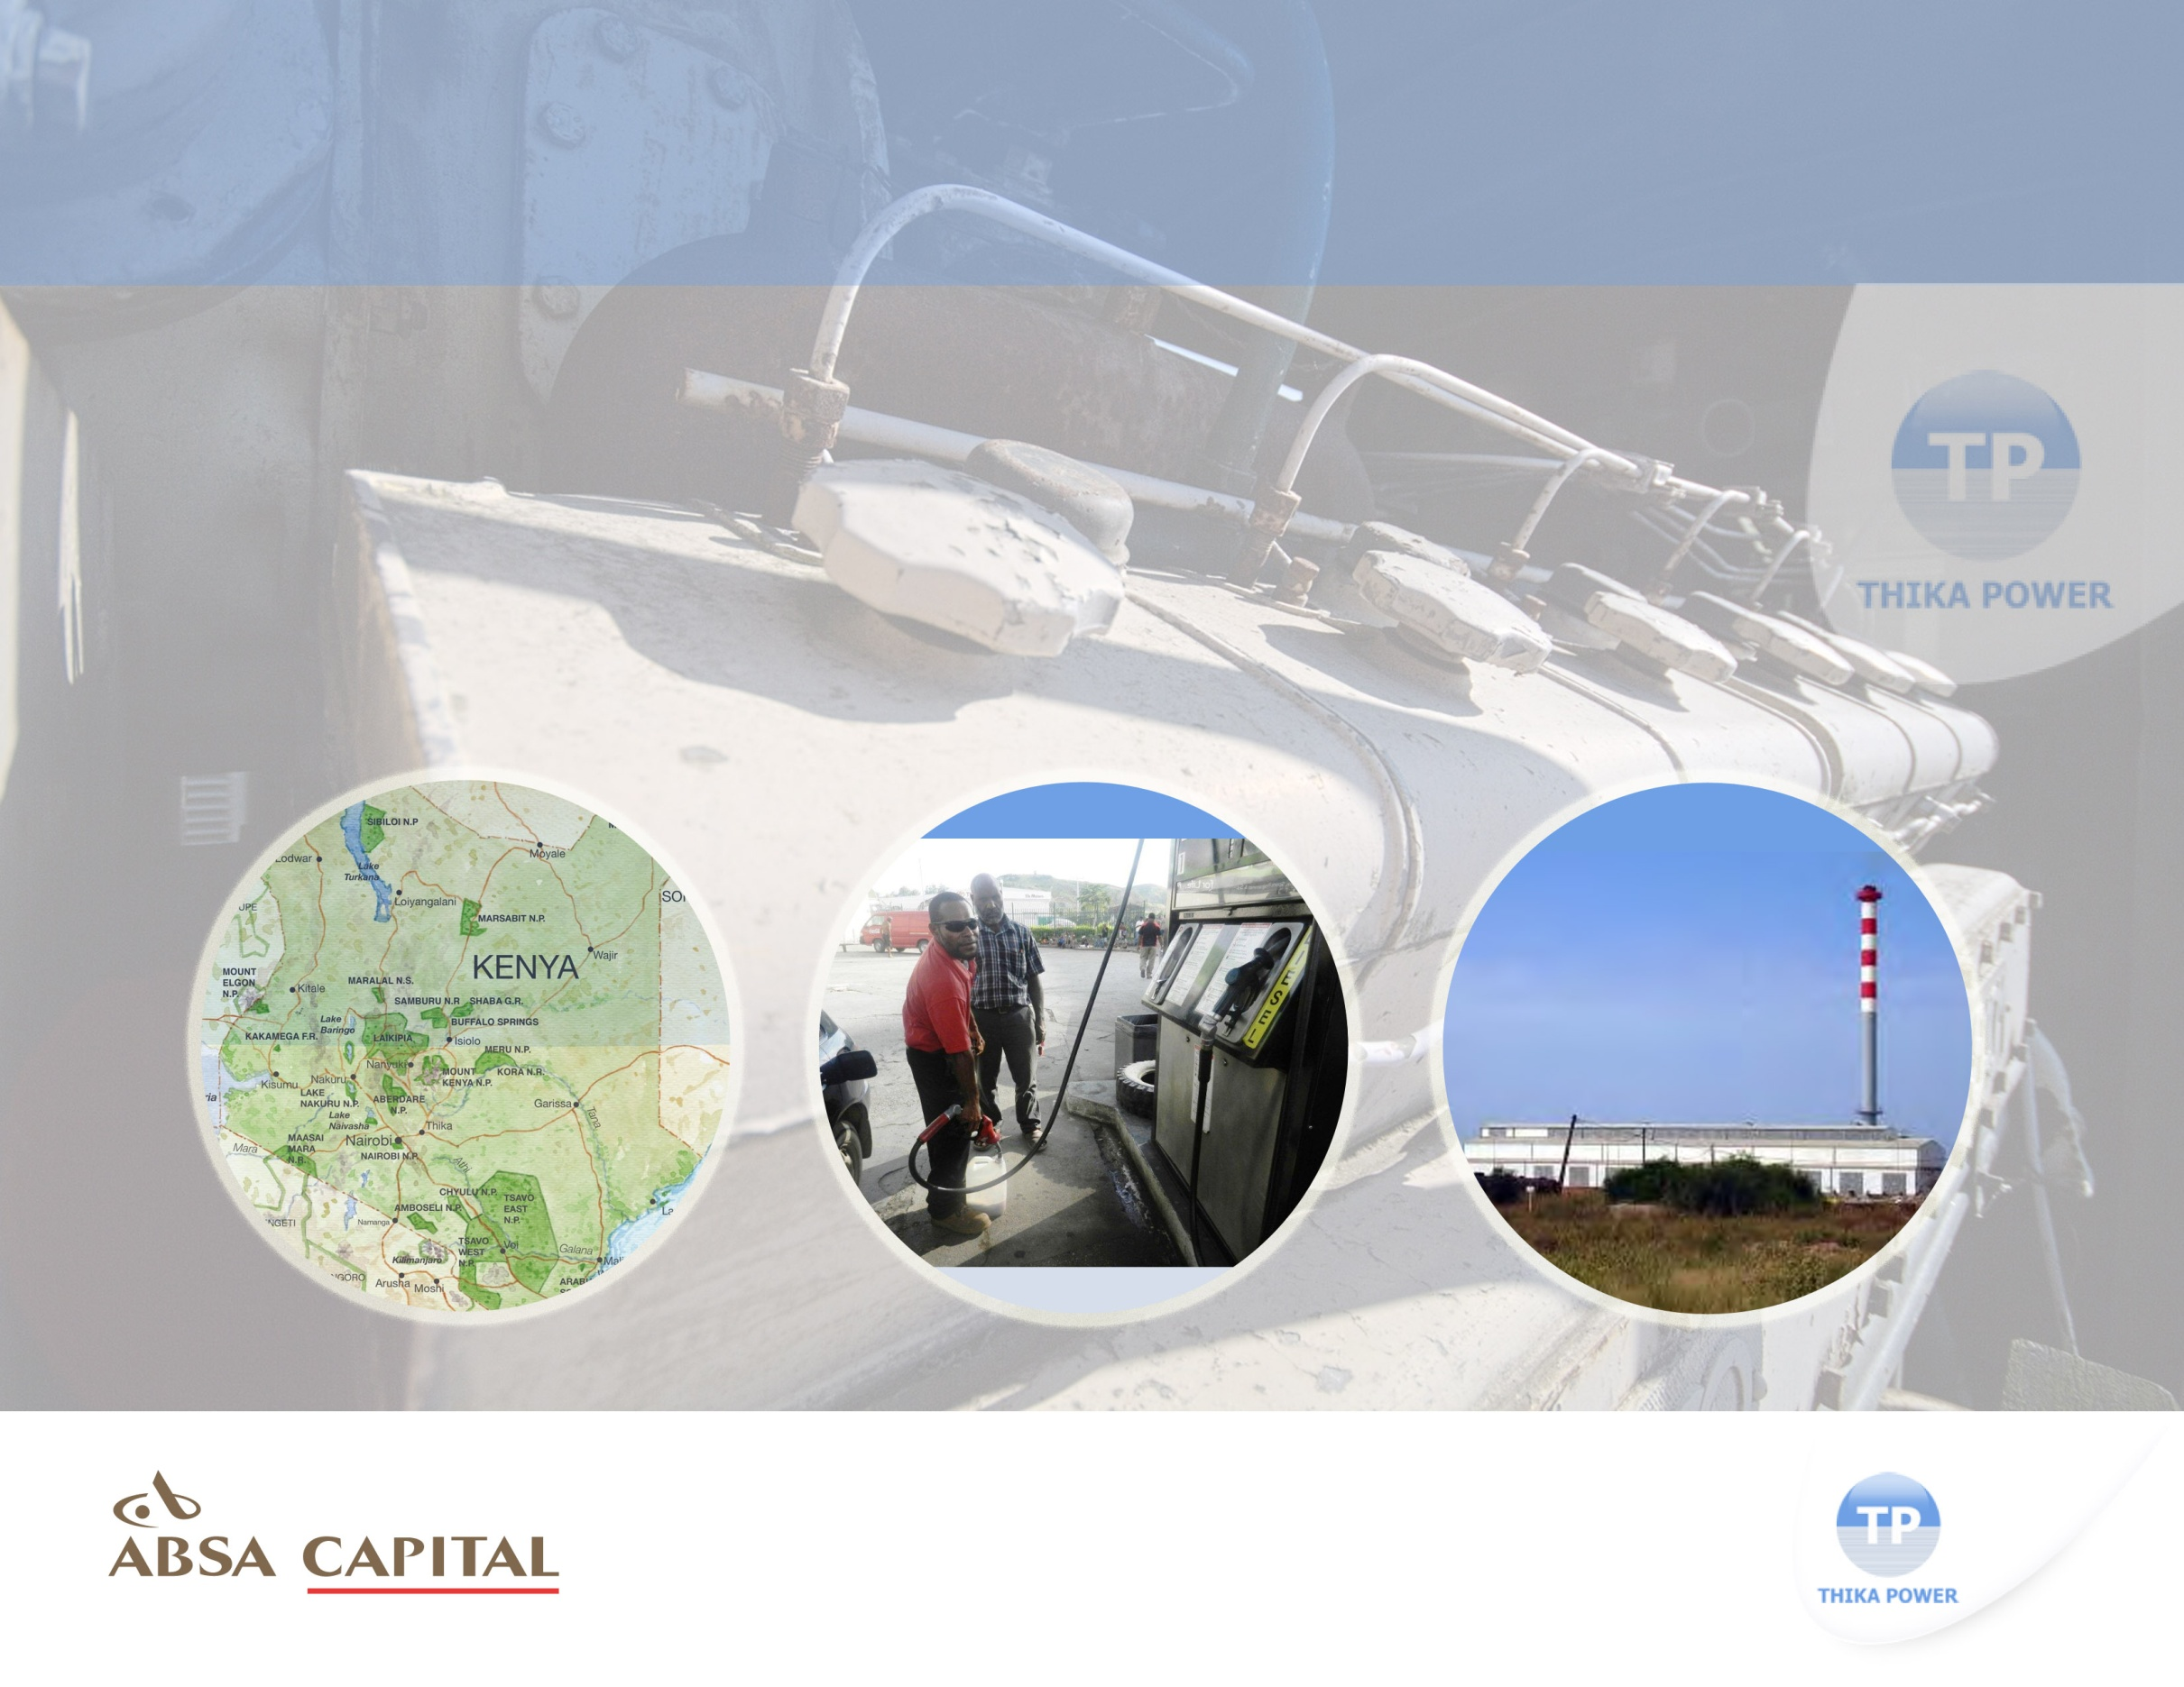
Thika Power Project
Omar Vajeth
Head of Power, Utilities and Infrastructure
Absa
Confidential Presentation

Slide 2
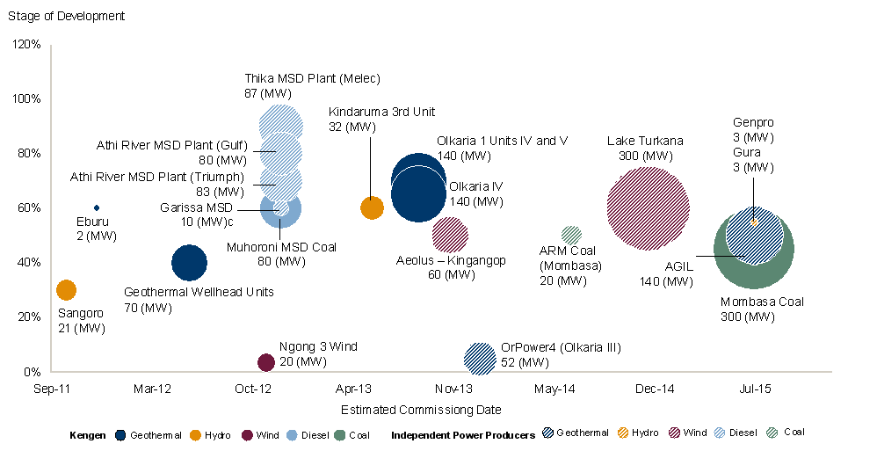
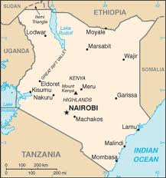
Introduction
Thika Power Project
Availability of adequate and reliable power supply is critical for the success of Kenya and achievement of the country’s long term goals
Country Overview
Sector Planning
Total installed capacity increased from 1,473MW in 2010, to 1,589MW in 2011. Looking ahead, the peak load is projected to grow to about 2,500MW by 2015 and 15,000 MW by 2030.
Projected installed capacity needs to increase gradually to 19,200 MW by 2030 leaving leave the system with a reserve margin of 15%.
Planning of the Kenyan electric power sub-sector is met via the Least Cost Power Development Plan (“LCPDP”) of which the Project plays an important role
The need for the latest round of medium-speed diesel power plants was anticipated at the end of 2012
The Thika Power Project is the first of these projects to have financial close
Geographic Location
Planned Generation Capacity
Located in Thika near the vicinity of an industrial heartland
PPA
1
Notes:
12/7/2012 2:50 PM

Slide 3
Project Overview
Thika Power Project
This project represents a significant milestone given its numerous success factors
Project Overview
Key Success Factors
Thika Power Limited (“TPL”) successfully bid through a competitive tender process for purpose of designing, constructing and operating a new 87MW heavy-fuel oil fired independent power plant located in Thika, Kenya
TPL is owned 90% by Melec PowerGen (BVI) and 10% by the local Africa Energy Resources Pte Ltd.
The total project cost is Euro 112,4 million and was financed on a limited recourse basis of 75:25
TPL has entered into a 20-year capacity-based Power Purchase Agreement (“PPA”) with Kenya Power & Lighting Company (“KPLC”)
Moreover, the Government of Kenya issued a Letter of Support (“LOS”) to support KPLC obligations under the PPA
The debt financing, with a tenor of 15 years, is being provided by IFC, AfDB, and ABSA, a consortium comprising of a mix of DFI and commercial bank financing.
Country and sector benchmarking
  Kenya has a track record of over 16-years in the IPP field
  Strong and commercially viable off-taker
  Strong independent and transparent regulator with consistent tariff setting
Robust deal structure
  Robust risk allocation
Committed south-south development
  This is the second IPP that Melec PowerGen have developed
Least cost thermal power alternative
  Engines are expected to have superior thermal efficiency
2

Slide 4


Robust Deal Structure
Thika Power Project
The first project in sub-Saharan Africa to make use of the Industrial Development Association (“IDA”) Partial Risk Guarantee (“PRG”) L/C Structure
Structure Highlights
Transaction Structure
Robust risk allocation where commercial and political event risks are separated and allocated to the off-taker, through the PPA, and to the GoK, through a LOS
The project made use of the innovative IDA PRG L/C Structure for Credit support. This is where IDA PRG provides a backstop for liquidity payments of the off-taker by providing a guarantee to the L/C bank. This allowed the project to be supported by the GoK despite limitations by KPLC’s balance sheet in terms of offtaker credit worthiness
In addition, MIGA cover was provided for the commercial bank with minimal cost through the MIGA Breach of Contract cover to backstop potential PPA & Letter of Support termination payments to commercial lenders and the swap provider only.
Full interest rate coverage provided through a single interest for the full tenor
Project Agreement
IDA
Government of Kenya
Indemnity
Agreement
Government
Guarantee Agreement
L/C Bank
Standby
L/C
L/C
Reimbursement
Obligations
Support
Agreement
Project Company
World Bank
KPLC
PPA Guarantee
PPA
Credential
87 MW Fuel Power Plant
Kenya
EUR112m
Commercial Mandated
Lead Arranger
Hedge Bank
October 2012
3

Slide 5
Risk Flow Analysis
Thika Power Project
The diagram below illustrates the comprehensive nature of the risk strategies used mitigate all Kenyan political risk and KPLC [off-taker] risk associated with the Project. In essence, the only risks that are not covered by the MIGA insurance are specific project risks that include sponsor risk, construction risk, operating risk and fuel supply risk. These risks are mitigated using standard project finance techniques
Risk Flow Analysis
Standard FM affecting total Project
Due to FM, in short defined as:
Act of God
Epidemics or plagues
Explosions or chemical contamination (other than act of war)
Labour disputes including strikes, works to rule, go slows etc.
If FM continues for 180 days and remains unsolved for an additional 90 days and TPL continues to receive “Capacity, Energy and Fuel Payments”.
TPL may terminate the PPA on the 271st day.
TPL request a “Transfer Amount” from KPLC. (“Transfer Amount” equals “Total Project Cost” less 5% depreciation for each year after commercial operation date).
Total Project Cost” to be agreed within 60 days and payable within 120 days thereafter.
The plant will be transferred from TPL to KPLC on receipt of “Total Project Cost” payment.
KPLC fails to pay “Total Project Costs” and TPL defaults on its payments to Absa,
Absa claims under MIGA Breach of Contract insurance cover.
MIGA has a 180 day waiting period required for a mediation/arbitration process with GoK.
Once claim is considered complete, MIGA will pay within 30 days (including accrued interest).
Maximum period: 390 days (i.e. 60+120+180+30, no reason to call on facility if lenders are receiving debt repayments during the 270 day period).
The project defaults in terms of the PPA.
Due to a Force Majeure (“FM”) Event
Political risk affecting total Project
Due to a Political FM in summary defined as:
Any blockade, embargo, riot, insurrection, civil commotion or any act of sabotage;
Change in Law and/or Change in Tax;
Any expropriation, confiscation etc.
war or act of foreign enemy;
Any FM affecting KPLC’s ability to pay;
Any failure by a Governmental Authority to issue or renew any Authorisation required.
GoK fails to pay “Total Project Costs” and TPL defaults on its payments to Absa,
Absa claims under the MIGA insurance that backstops all the clauses of the GoK LoS.
MIGA has a 180 day waiting period required for a mediation/arbitration process with GoK.
Once claim is considered complete, MIGA will pay within 30 days (including accrued interest).
Maximum period: 570 days (i.e.180+60+120+180+30).
If FM continues for 180 days and “Capacity Payments” are not being made.
TPL may terminate the PPA and request a “Transfer Amount” under the GoK LoS.
Total Project Cost” to be agreed within 60 days and payable within 120 days thereafter.
The plant will be transferred from TPL to GoK on receipt of “Total Project Cost” payment.
After LC has been exhausted TPL has the right to terminate the PPA and claim for the “Total Project Cost” from KPLC. “
Total Project Cost” to be agreed within 60 days and payable within 120 days thereafter.
The plant will be transferred from TPL to KPLC on receipt of “Total Project Cost” payment.
KPLC fails to pay “Total Project Costs” and TPL defaults on its payments to Absa,
Absa claims under MIGA Breach of Contract insurance cover.
MIGA has a 180 day waiting period required for a mediation/arbitration process with KPLC.
Once claim is considered complete, MIGA will pay with 30 days (including accrued interest).
Maximum period: 390 days (60+120+180+30).
TPL has the option to call under the IDA guaranteed LC up to 3 “Capacity Payments” and 2 “Fuel Payments” Amount capped at EUR32mn plus US$8mn
KPLC Default
4

Slide 6
Disclaimer all ex Ita,MEast
This document has been prepared by Barclays Bank PLC, acting through its investment bank (“Barclays”), for information purposes only. This document is an indicative summary of the terms and conditions of the securities/transaction described herein and may be amended, superseded or replaced by subsequent summaries. The final terms and conditions of the transaction and any related security will be set out in full in the applicable transaction confirmation, offering document(s), pricing supplement or binding transaction document(s).
This document shall not constitute an underwriting commitment, an offer of financing, an offer to buy or sell, or the solicitation of an offer to buy or sell any securities described herein, which shall be subject to Barclays’ internal approvals. No transaction or service related thereto is contemplated without Barclays’ subsequent formal agreement.
Barclays is acting solely as principal and not as advisor or fiduciary. Barclays does not provide, and has not provided, any investment advice or recommendation to you in relation to the transaction and/or any related securities described herein and is not responsible for providing or arranging for the provision of any general financial, strategic or specialist advice, including legal, regulatory, accounting, model auditing or taxation advice or services or any other services in relation to the transaction and/or any related securities described herein. Accordingly Barclays is under no obligation to, and shall not, determine the suitability for you of the transaction described herein. You must determine, on your own behalf or through independent professional advice, the merits, terms conditions and risks of the transaction described herein. You must also satisfy yourself that you are capable of assuming, and assume the risks of any such transaction. Neither Barclays nor any of its subsidiaries, affiliates or ultimate holding company, nor any of the subsidiaries or affiliates of such holding company (the“ Barclays Group”), nor any of their respective directors, officers, employees, representatives or agents, accepts any liability whatsoever for any direct, indirect or consequential losses (in contract, tort or otherwise) arising from the use of this document or its contents or reliance on the information contained herein.
Barclays does not guarantee the accuracy or completeness of information which is contained in this document and which is stated to have been obtained from or is based upon trade and statistical services or other third party sources. Any data on past performance, modelling, scenario analysis or back-testing contained herein is no indication as to future performance. No representation is made as to the reasonableness of the assumptions made within or the accuracy or completeness of any modelling, scenario analysis or back-testing. All opinions and estimates are given as of the date hereof and are subject to change. The value of any investment may fluctuate as a result of market changes. The information in this document is not intended to predict actual results and no assurances are given with respect thereto.
Barclays is a full service securities firm engaged in a wide range of businesses and from time to time, in the ordinary course of its business, Barclays and/or other parts of the Barclays Group may hold long or short positions and trade or otherwise effect transactions for their own account or the account of their customers in the securities referred to herein and/or the debt or equity securities, assets or loans (or any derivatives thereof) of the companies referred to herein. Additionally, Barclays and/or other parts of the Barclays Group may have investment and commercial banking, lending, asset management and other relationships with parties which are or may become involved in the transactions referred to herein and/or which may have interests which could potentially conflict with the interests of the recipient hereof. Barclays and/or other parts of the Barclays Group have in place policies and procedures to restrict the flow of information and to identify, consider and manage such potential conflicts of interest. Accordingly, you acknowledge and agree that no part of the Barclays Group is required to restrict its activities as a result of the provision of this document, and that all parts of the Barclays Group may undertake any activities without further consultation with or notification to you. Barclays shall not be required to account to you for any revenue or profits obtained in connection with any activities of the Barclays Group as referred to herein.
Barclays’ research analysts and research departments are independent from Barclays’ investment banking division and are subject to certain regulations and internal policies. Barclays’ research analysts may hold and make statements or investment recommendations and/or publish research reports with respect to any company referred to herein, the transactions contemplated herein or any person involved therein or related thereto that differ from or are inconsistent with the views or advice communicated by Barclays’ investment banking division.
Barclays Bank PLC is authorised and regulated by the UK Financial Services Authority and a member of the London Stock Exchange. Barclays Bank PLC is registered in England No. 1026167. Registered Office: 1 Churchill Place, London E14 5HP. Copyright Barclays Bank PLC, 2012 (all rights reserved).
This document is confidential, and no part of it may be reproduced, distributed or transmitted without the prior written permission of Barclays.
5

