Slide 1
PPPs in water and sanitation Ensuring Foundations of Equal Access to Infrastructure
World Bank Group
Law Justice and Development week
13 December, 2012
Jane Jamieson
Senior Industry Specialist, IFC Advisory
Victoria Delmon
Senior Counsel,
World Bank Legal VPU
Notes:
1

Slide 2
Water Sector – Challenges
Urban
Water - Piped water systems
Low cost recovery
Lack of maintenance and investment
Intermittent supply
Poorer communities unserved
Poor quality water
Theft of water
Private providers filling gaps
Sanitation
Limited sewerage networks
Septage
Little sewage treatment
Rural
Water
Community run systems
Small schemes/ water kiosk
Limited household connections
Distant river source
Sanitation – very little
Notes:
Strong policy and regulatory environment
Well established market

Slide 3
Opportunities and challenges
Opportunities
Huge investments required
Sanitation treatment and systems
Water treatment – desalination + traditional
Subsidies for new connections - GPOBA
Challenges
Water is a public good
Free
Public provision
Water born disease is huge killer but water is not political high priority
Significant vested interests in keeping status quo (lots of theft)
Some poor performance of water PPPs
Water resources shared with agriculture and industry
Notes:
Strong policy and regulatory environment
Well established market

Slide 4
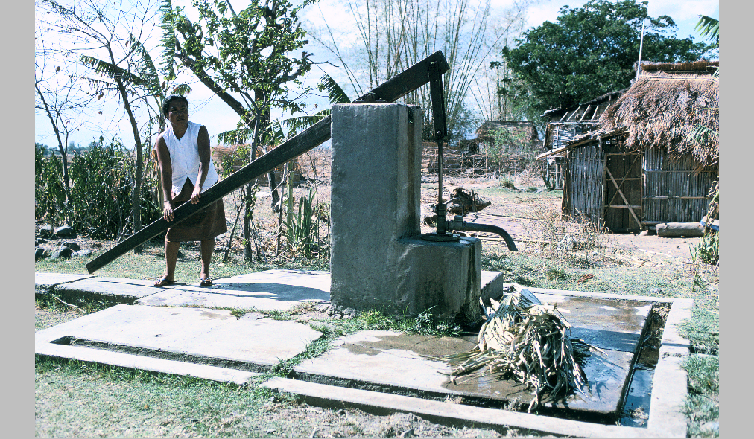
Water – World Bank Group
WBG pillar: promote broad access to water and food security
World Bank Group initiatives/ trust funds:
Water and Sanitation Program
GPOBA (Global Partnership on Output Based Aid)
Water Partnership Program
IFC Advisory Services
World Bank and IFC investments
Notes:
Strong policy and regulatory environment
Well established market

Slide 5
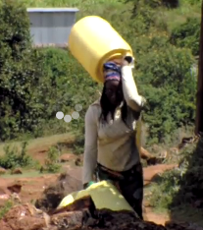
Rural communities - challenges:
Some of poorest and most marginalised sections of society
Significant water requirements (farming and domestic)
Often far from a source of safe and clean water
Women and girls typically fetch water
State water service providers often do not serve these communities
High charges for water to private schemes
Notes:
Strong policy and regulatory environment
Well established market

Slide 6
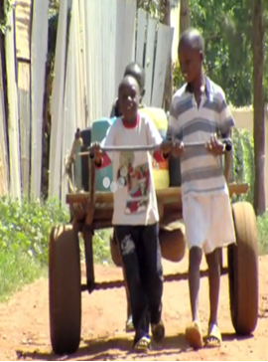
PPP in rural water provision - challenges:
Low capacity
Need for capital investment
Lack of funding
Often no or limited legal or regulatory framework
Where there is a framework, this is not implemented well
Concept of formal rule of law limited – justice may be based on customs or community based
Land title issues
Who should regulate arrangements?
6
Notes:
Strong policy and regulatory environment
Well established market

Slide 7
PPP Contracts for rural water projects: Sub-Saharan Africa, Asia, Latin America
Limited market - Start small - management and affermage contracts
Lack of private funding sources - Limited investment
Short term (1 – 3 years)
Keep simple
Find effective monitoring and regulatory mechanisms
Move to longer contracts once have established players
Move to clusters – economies of scale
Increase obligations of private sector (move to BOTs?)
Longer duration contracts
Improve bankability of projects
7
Notes:
Strong policy and regulatory environment
Well established market

Slide 8
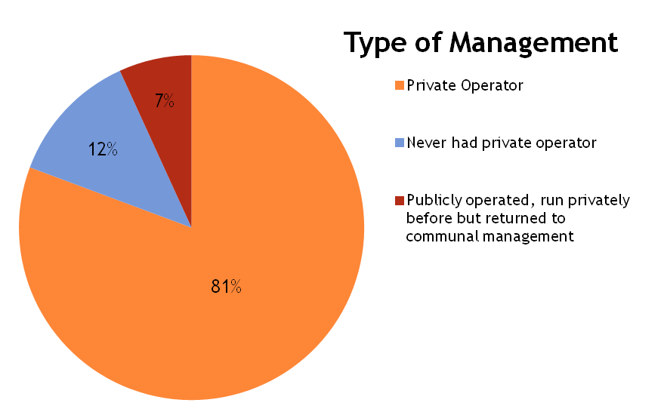
Uganda small town water sector
156 small towns with 2.4 million people
54% safe-water coverage in Small towns
105 operational small towns with piped water supply schemes
Mostly management contracts, little PS investment in financing
Average tariff around US$0.9/m³ sufficient to cover O&M costs
Review of Small town PSP, MWE Uganda/WSP 2012
Notes:
Uganda has a long history of PSP in small towns, over ten years
Strong policy and regulatory environment and procedures for contracting the private sector
Well established market with the majority of provision from domestic private sector

Slide 9
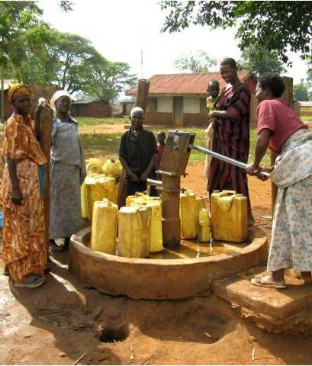
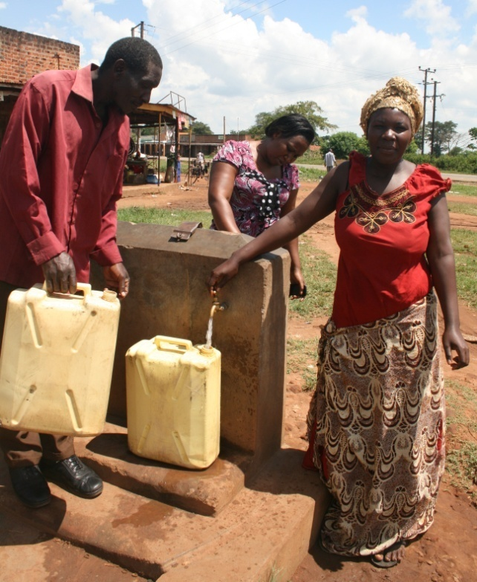
Rural Water PPP transactions Uganda - Busembatia
336 existing water connections with intermittent service
Producing 8m³/hour
Collection Efficiency of 70%
After
Before
745 connections, mainly yard taps and 17 standpipes, 24/7 service
Producing 21m³/hour
Collection Efficiency of over 85%
Performance based contract incentivized private sector investment
Longer contract period ensures cost recovery
Access to finance through local banks
Transition to a PPP model where private sector is taking more of the construction and financing risk
Outcomes
Notes:
Busembatia town of around 15,000 people existing poor level of service, long distances to communal water sources, often handpumps
IFC supported the developed a “new generation” PPP Contract to be adopted for small town water PPP arrangements
5-year agreement with local private operators to provide access to affordable drinking water in the town of Busembatia, Uganda.
Used a performance based payment mechanisms, Output Based Aid incetivise PS to invest upfront and payment on results.
New business opportunity for local banks$100K loan to winning bidder
Extended the minimum term (duration) for PPP contract from 2 years to 5 years
Way of removing dependence on public funding, operator for this scheme took the approach to other town where public funds
Shift in the mind set of governments to move to a more performance based mechanisms rather than relying on public funding for capital investment.

Slide 10
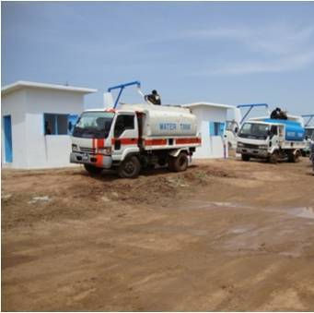
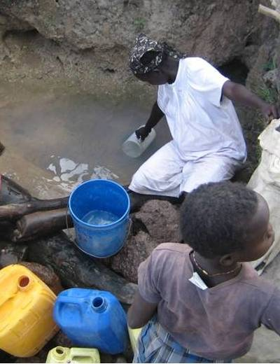
South Sudan
Population of 8.26 million; water coverage is estimated at 27%
Rapidly growing demand; public service cannot keep pace, the national water supply company (SSUWC), serves less than 20% of the population in 6 main towns
Existing informal market; hundreds of trucks, donkey cart and bicycles carrying and selling water in large cities as well as in small towns.
Poor quality service is very expensive (8 to 12 $ per m³) so households often resort to travelling long distances to access unsafe sources
Photos courtesy of MWRI S Sudan

Slide 11
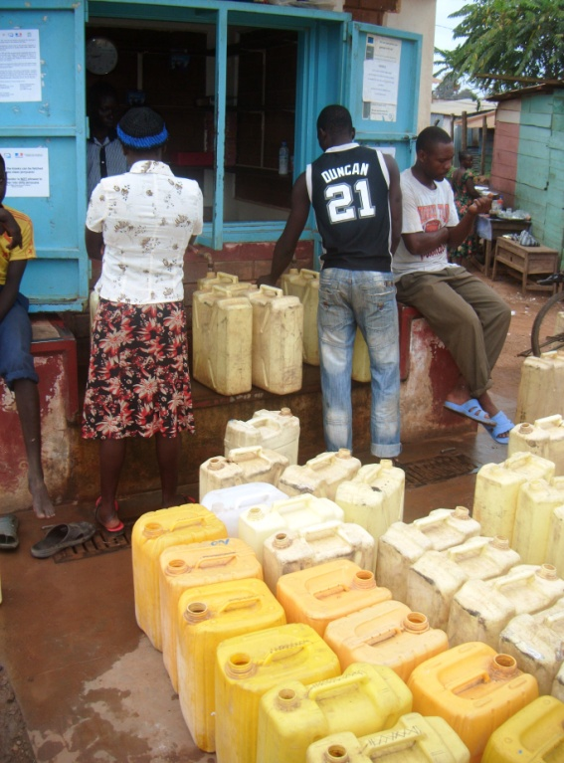
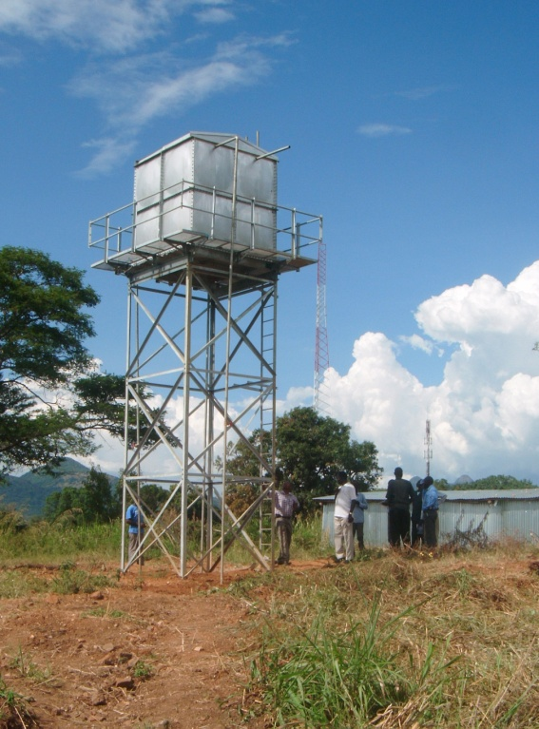
South Sudan Enabling Environment
National Water Policy promotes the develop of private sector provision of water services, however this has not yet been enacted into law.
Lack of clarity on role of national versus state government, sometime contradictory policies in place.
Land an incredibly sensitive issue holding back development.
Main challenge is to harness the entrepreneurial informal market to delivery of safe affordable water.
Notes:
IFC proposing a learning by doing approach
Starting small and see what can be done.

Slide 12
Different situations offer different challenges and opportunities
Well established PPP market Uganda | Emerging post conflict market South Sudan
Clear policy environment | Lack of policy environment
Regulated tariff, covering O&M costs | Informal open market has developed through necessity
Long experience and well established operators | Capacity and quality of service unknown
Mechanisms for regulating quality and level of service | Unregulated tariff and lack of government/donor investment therefore price of water more fully reflects costs
Well established government investment/procurement procedures so limited willingness to look at innovative new models | Main challenge is to harness this situation to delivery of safe affordable water

Slide 13
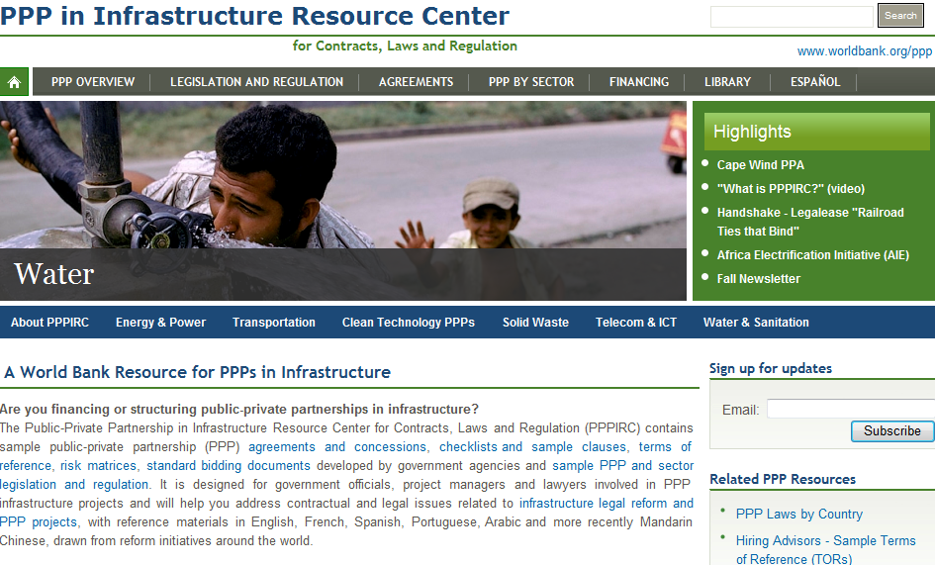

Slide 14
Key messages re rural and post conflict environments
Lack of legal or regulatory environment can present an opportunity
Design projects to fit circumstances – simple, easy to monitor (few clear performance requirements)
Theory and practice may vary – learn from pilot projects
There is a market for PPPs in these areas
PPP can serve to fill the gap that the public sector is not serving
PPP can be a tool for inclusion
14
Notes:
Strong policy and regulatory environment
Well established market

